Slide 1
Introduction to Web Development Tools and Basic HTML
By Asad Khan
Date:13-08-2024

Slide 2
Content
Install VS Code
Set Up VS Code Auto Saver and Prettier Extension
Understanding the Folder Directory Inside VS Code
Creating the First Web Page: `index.html`
Understanding the Basic File Structure (HTML, Head, Body)
VS Code Extension: Live Server
HTML Tags: `<p>`, `<h>`, `<br>`

Slide 3
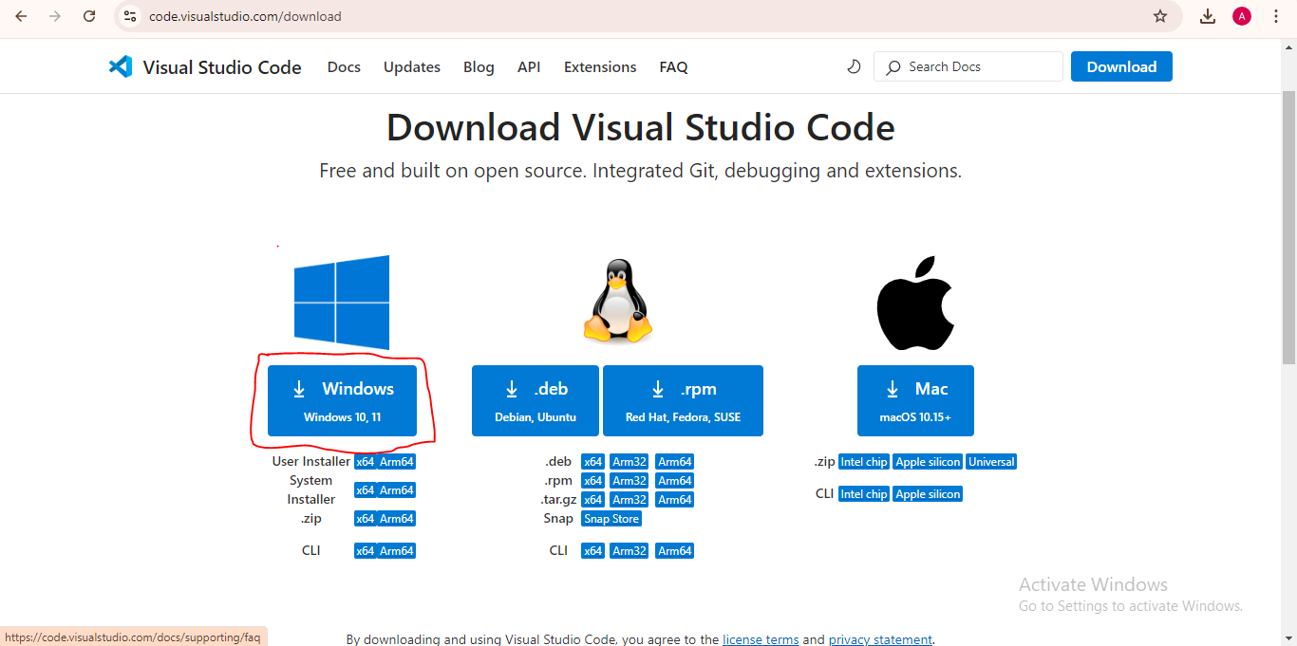
Download VS Code setup file
Type “download vs code ” in google chrome.
https://code.visualstudio.com/download
Download the compatible environment based vs code.

Slide 4
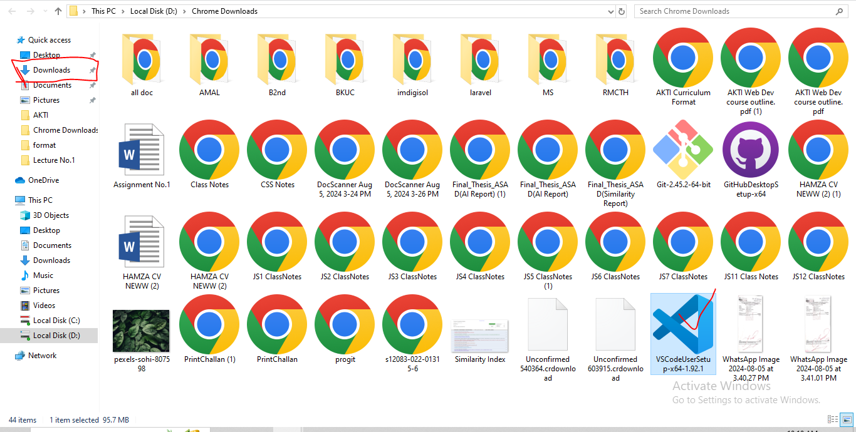
Install VS Code

Slide 5
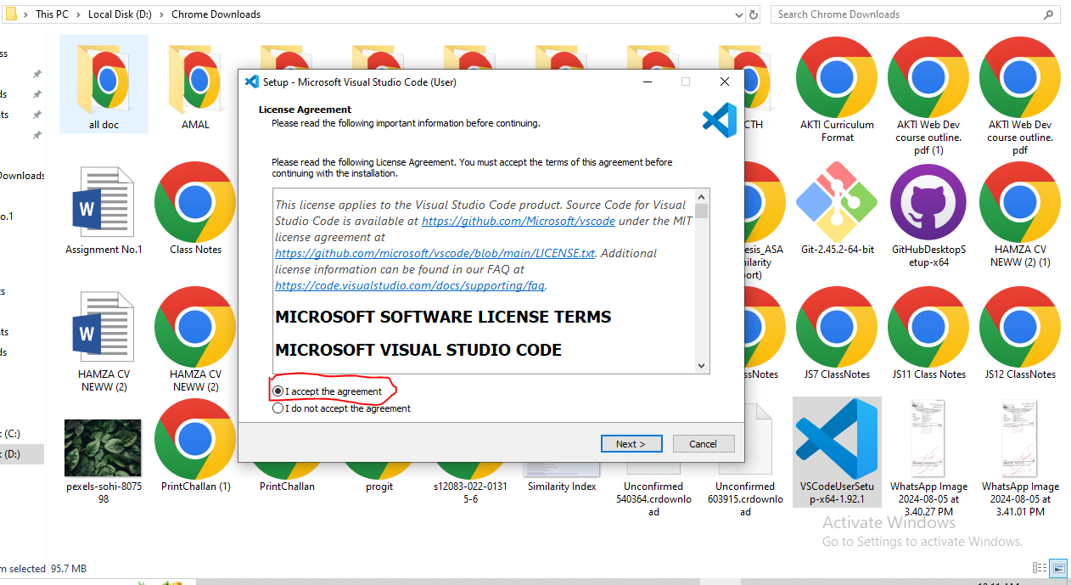

Slide 6
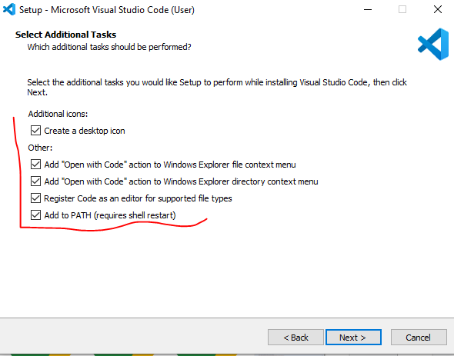
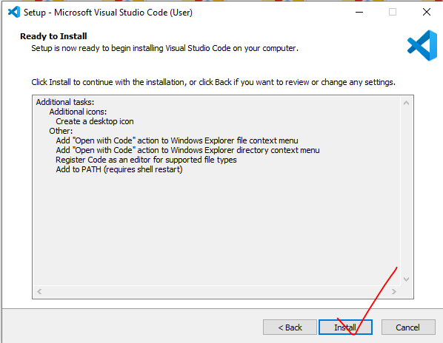

Slide 7

Understanding the Folder Directory Inside VS Code
Create a folder named "web development" on the desktop.
You can name the folder and directory as you like.
Open the folder, right-click on the desktop screen, and select "Open with VS Code.

Slide 8
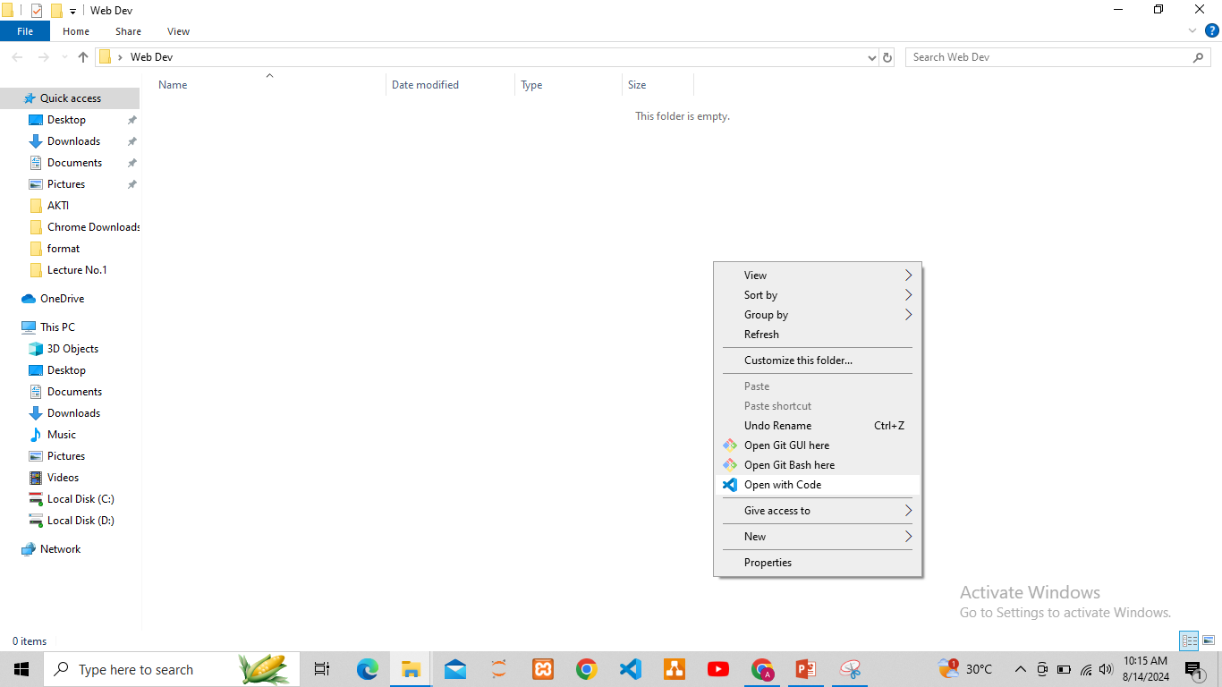

Slide 9
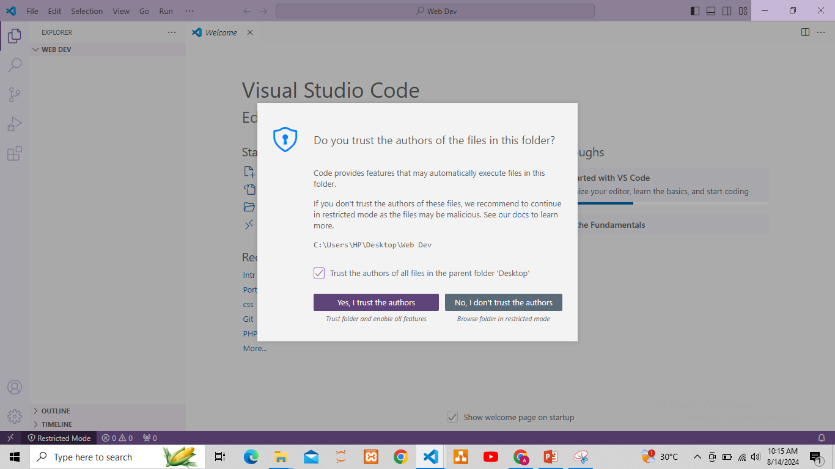
Now, accept the permission window by checking the checkbox, and click on "Yes, I trust the authors." Your folder is now open in VS Code successfully, so create a file named index.html and start coding...

Slide 10
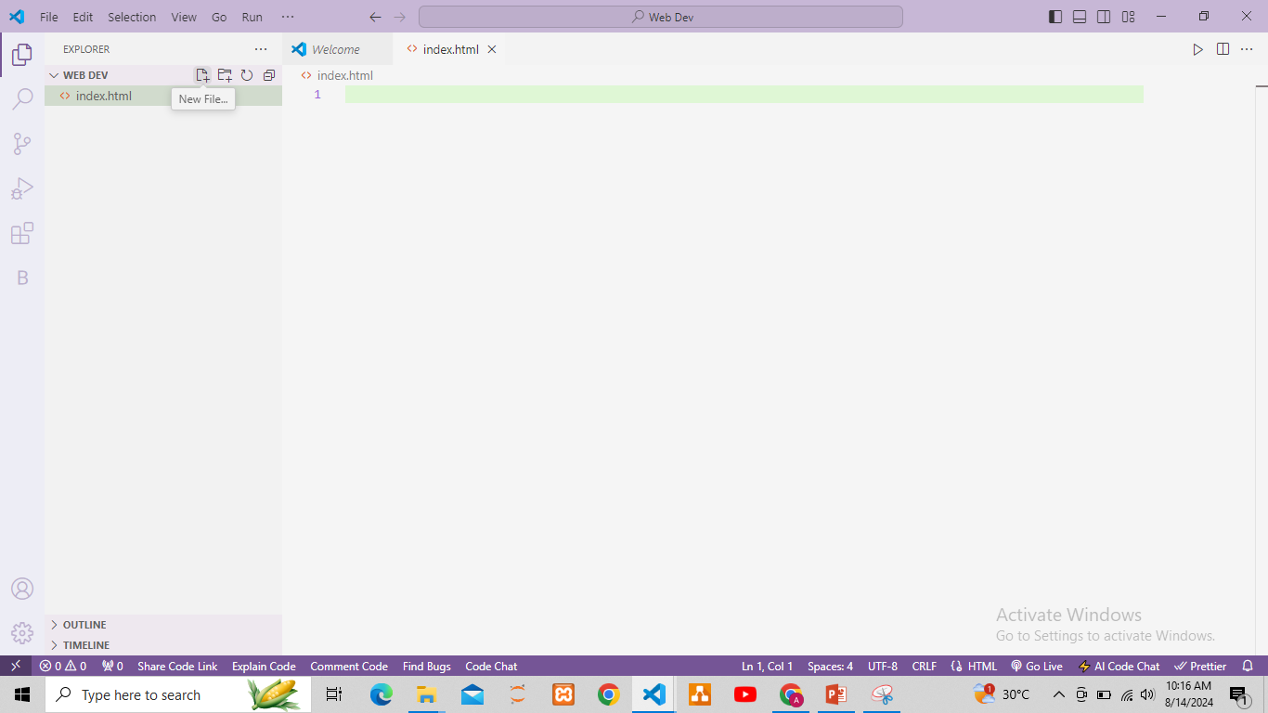

Slide 11
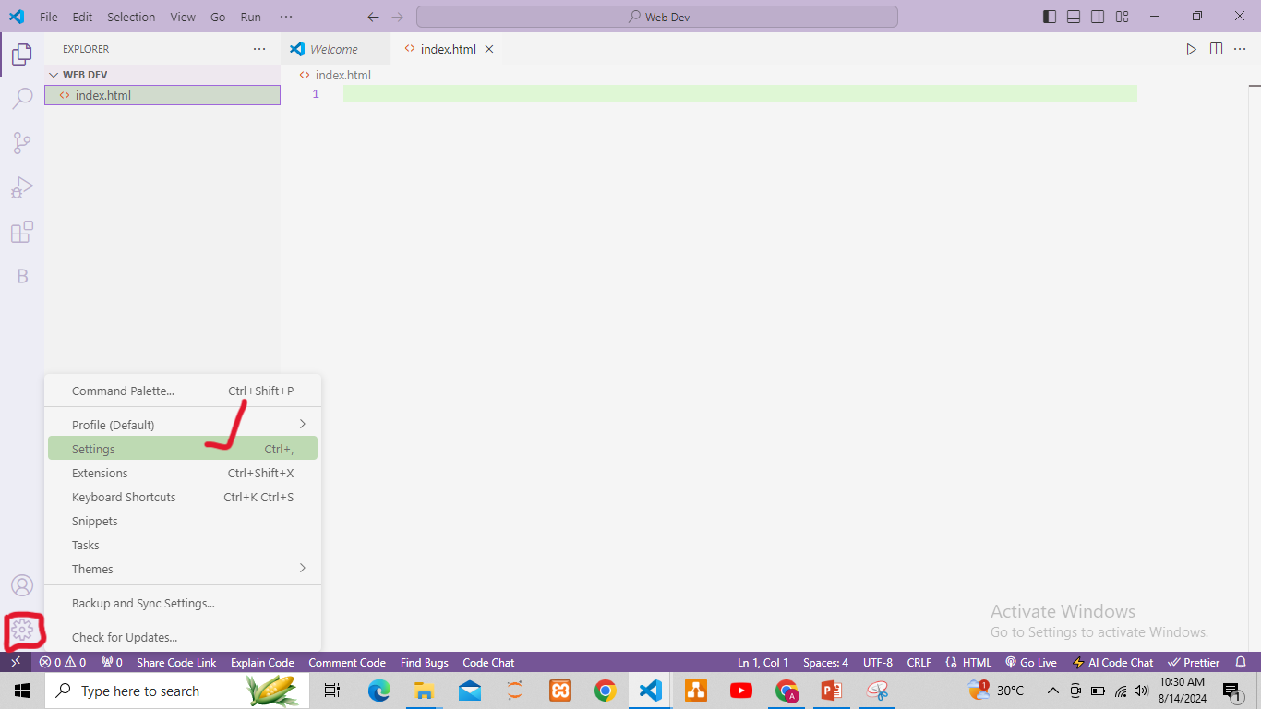
Setup vs code
From setting on auto saver on “afterDelay”.
Click on the settings icon in VS Code, search for 'Auto Save,' and in the drop-down menu, select the 'afterDelay' option. Close the tab to return to the index.html page.

Slide 12
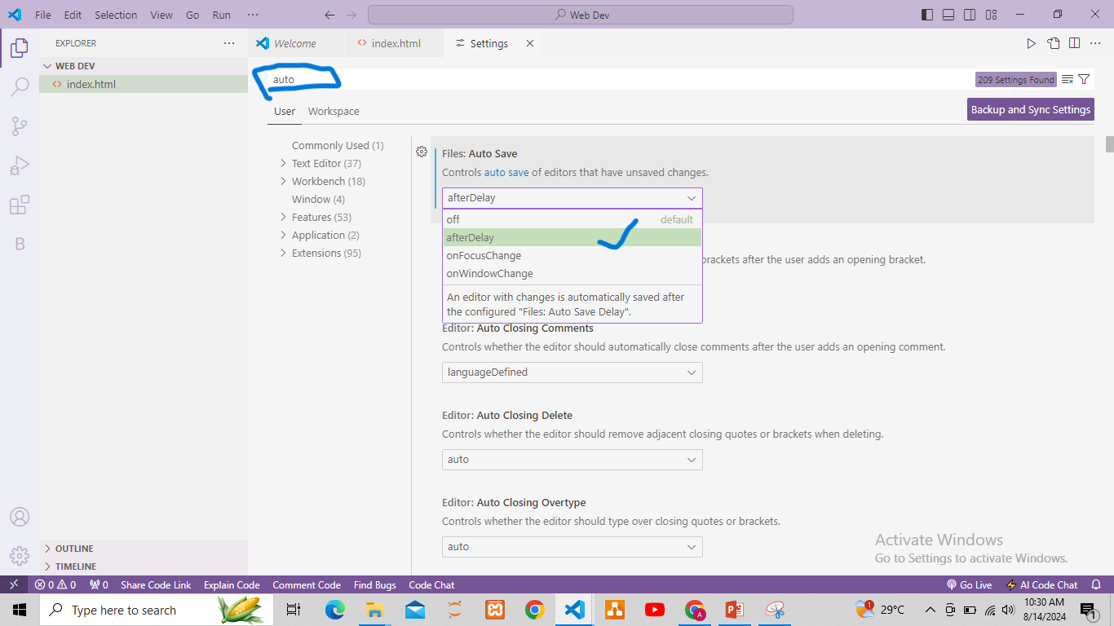
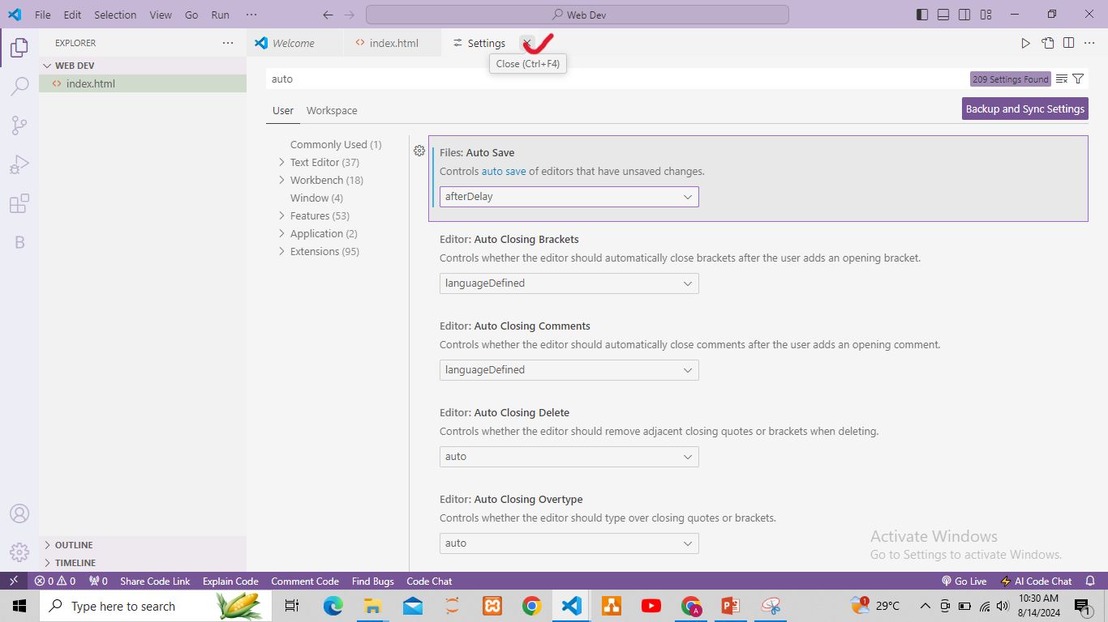

Slide 13
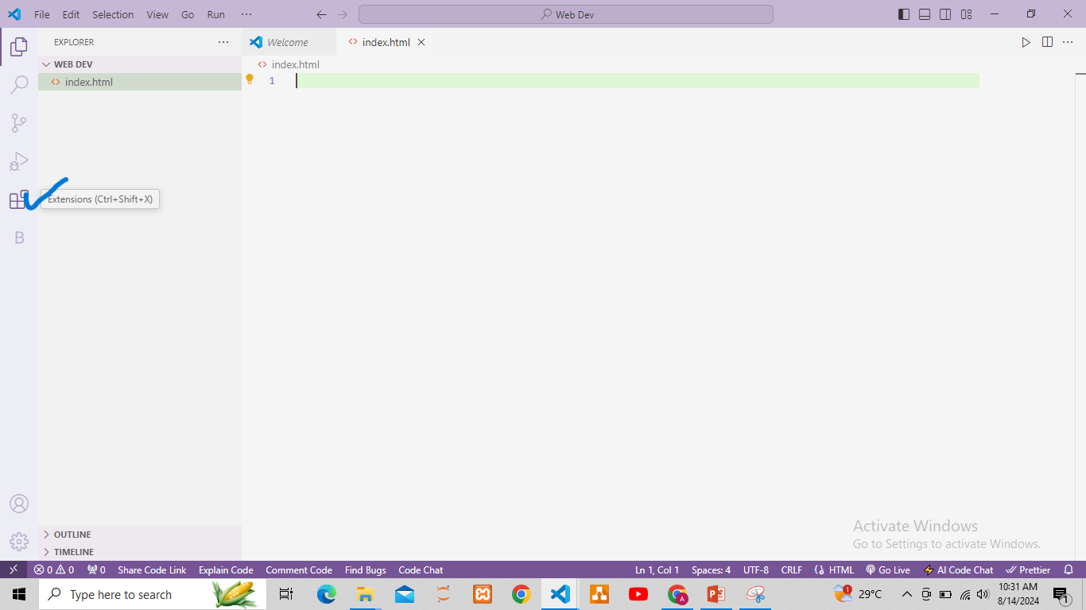
Install extensions
Install prettier extension for coding layout , due to which the code looks presentable and clean.

Slide 14
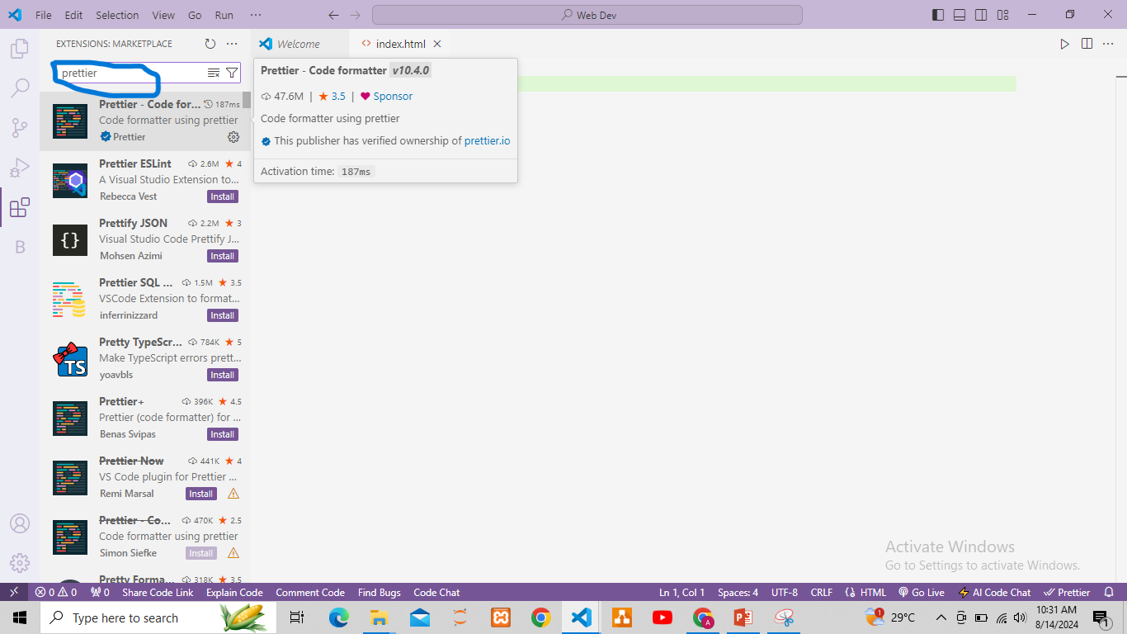
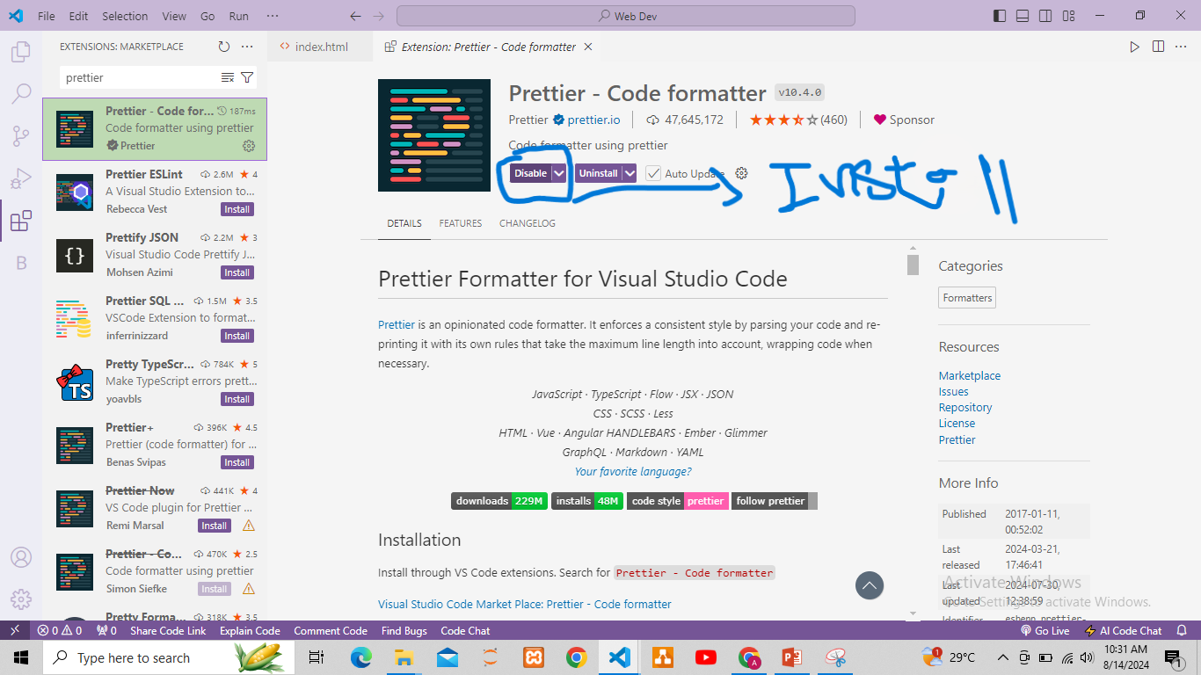

Slide 15
Creating First web page
<!DOCTYPE html> tell browser you are using HTML5
<html lang="en"> root of html document
<head> container for metadata
<title>Document</title> page title
</head>
<body> containing all data rendering by the browser
</body>
</html>
Save as: index.html
Extension : html
Index is home page for server to visit first.

Slide 16
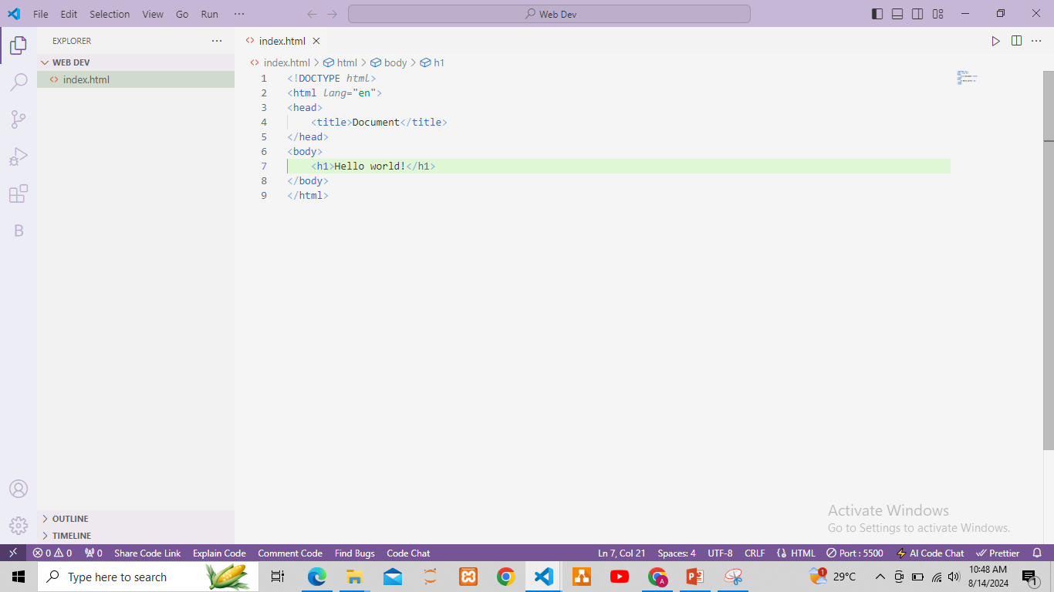

Slide 17
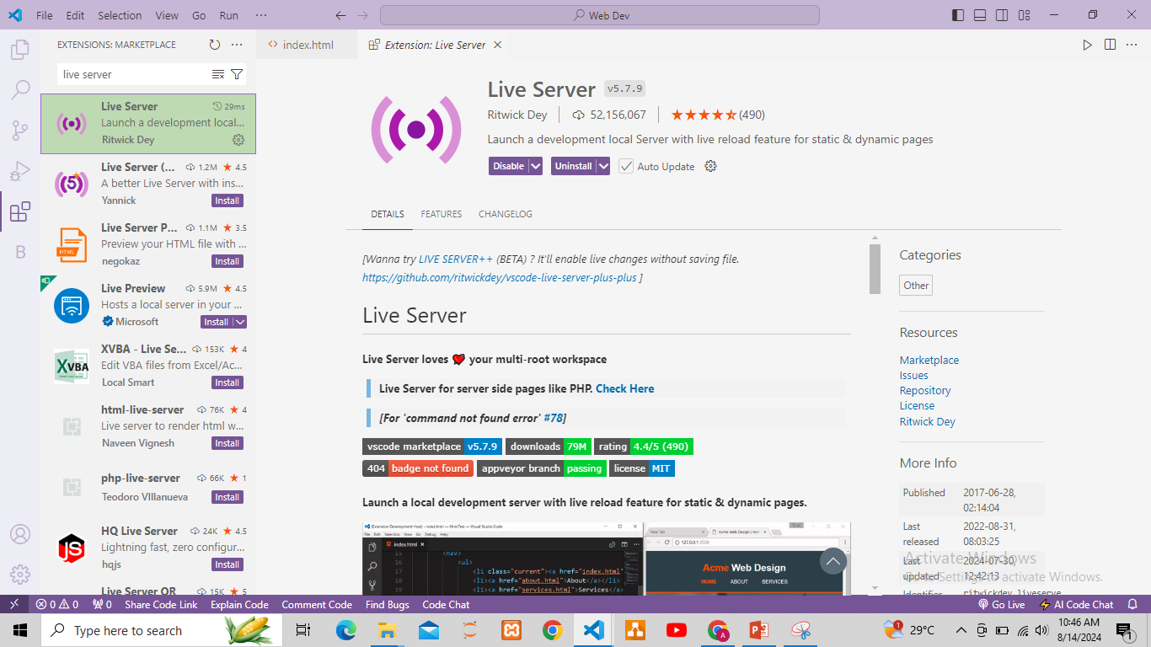
Live server extension
Go to extension section and install extension name “live server”.
Now click on live server on bottom right corner which will take you to browser while hosting your web page on server.

Slide 18
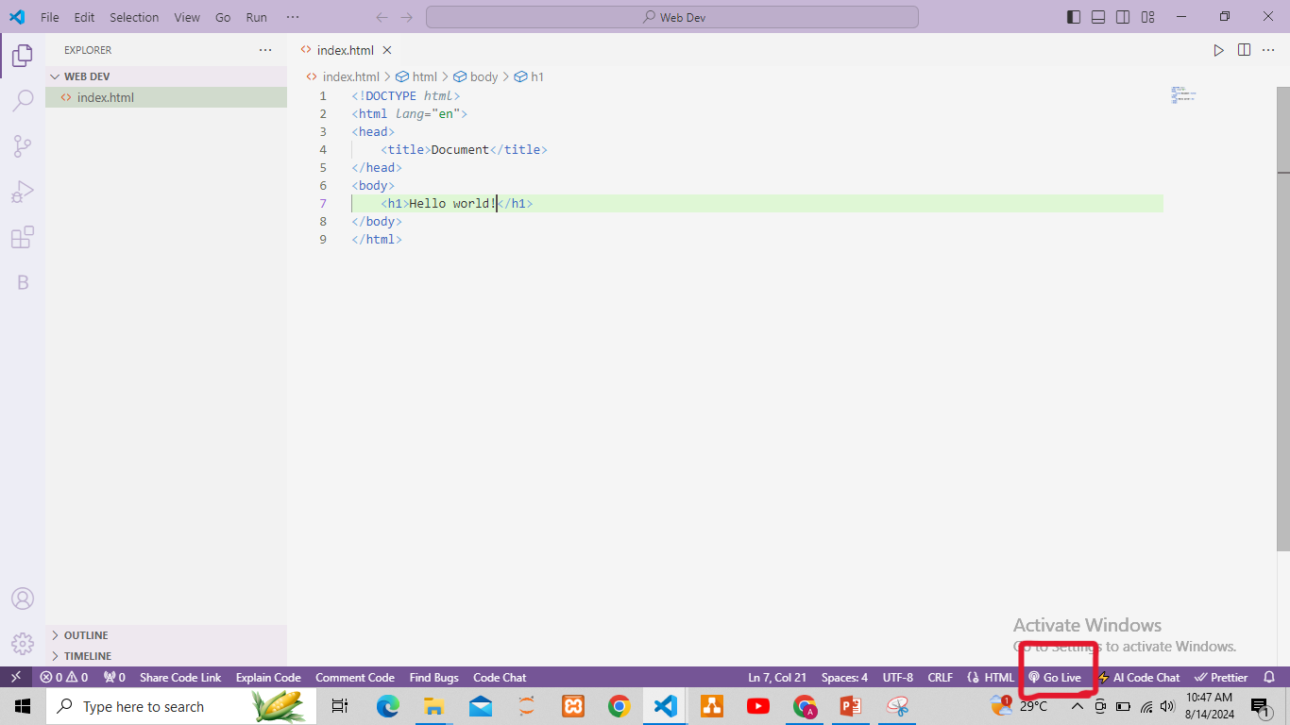

Slide 19
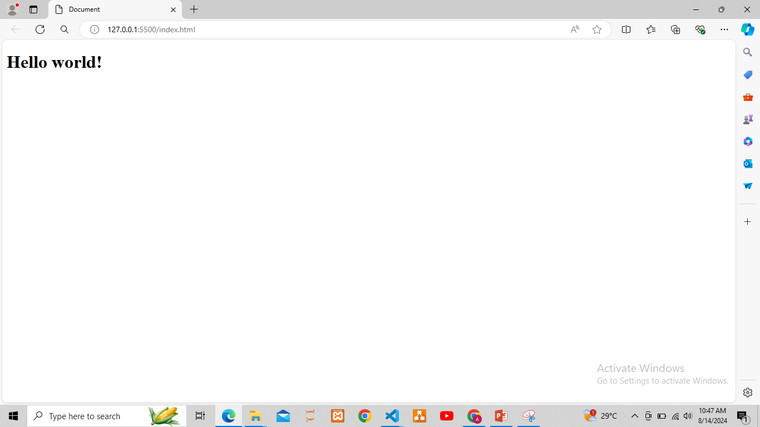

Slide 20
Heading tags
<h1> to <h6> Tags (Headings):
The `<h>` tags are used to define headings. `<h1>` is the highest (or most important) heading level, while `<h6>` is the lowest. Headings are also block-level elements.
Example:
<body>
<h1>This is a top-level heading</h1>
<h2>This is a second-level heading</h2>
.
.
<h6>This is last level heading </h6>
</body>

Slide 21
Paragraph tag
<p> Tag (Paragraph):
The `<p>` tag is used to define a paragraph in HTML. Browsers automatically add some space before and after each <p> element. Paragraphs are block-level elements, meaning they take up the full width available and start on a new line.
Example:
<p>This is a paragraph.</p>

Slide 22
Break tag
<br> Tag (Line Break):
The `<br>` tag is used to insert a line break in the text. Unlike `<p>` or `<h>` tags, it is an inline element and does not need a closing tag.
Example:
This is some text.<br>This text will be on a new line.

Slide 23
END THANK YOU!

